Slide 1
Brain Tumor Classification
Arefa Parwary, Riyad Bin Rafiq, Shoham Weiss

Slide 2
Contents
Dataset
Transfer learning
UNET and Saliency map
Custom CNN
Limitation and future work

Slide 3
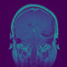
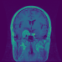
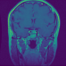
Dataset
Brain Tumor Image Dataset (MRI Images) from Kaggle.
Gathered by Southern Medical University, Guangzhou, China.
Contains 3064 T1-weighted contrast-enhanced MRI images from 233 patients:
Meningioma [708 slices]
Glioma [1426 slices]
Pituitary tumor [930 slices]
Figure 1. Left: Meningioma - usually appear as an enhancing mass on the outside lining of the brain tissue, which may or may not brighten with contrast. Malignant meningiomas can also invade the brain tissue. Middle: Glioma - called intra-axial brain tumors because they grow within the substance of the brain and often mix with normal brain tissue. Right: Pituitary tumor - and abnormal growth in the pituitary gland. The pituitary is a small gland in the brain. It is located behind the back of the nose.

Slide 4
Deep Learning Approaches
Classification:
Transfer Learning
Custom CNN
Localization:
Custom UNET
Gradient Tape

Slide 5
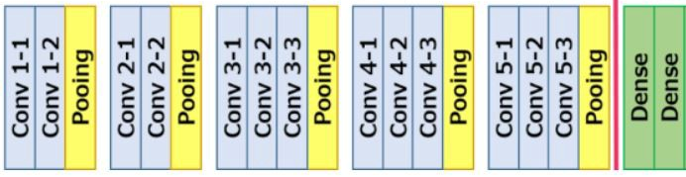
Transfer Learning: Methods
VGG-16 architecture
Output
(Classification)
Input
Non-trainable
Trainable

Slide 6
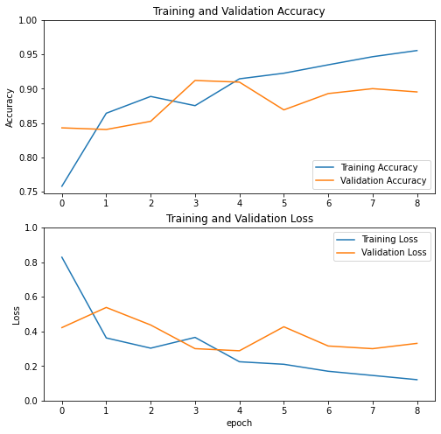
Transfer Learning: Results

Slide 7
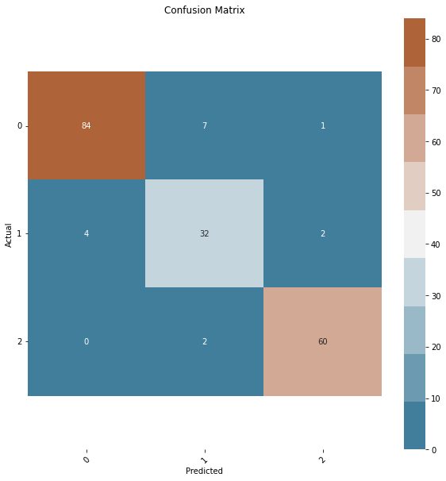
Transfer Learning: Results (Contd.)
Test set accuracy: 93.23%
Class | Precision | Recall | F1-score
Glioma | 95% | 91% | 93%
Meningioma | 78% | 84% | 81%
Pituitary tumor | 95% | 97% | 96%
Average | 90% | 91% | 90%

Slide 8
UNET Saliency Map: General Approach
Step 1: Train UNET
Step 2: Further train encoder as classifier
Input image (512x512x3)
Input image (512x512x3)
Encoder
(Conv Downstep)
Further train as classifier
Encoder
(Conv Downstep)
Latent (1x1x512)
Skip step
(512x512x1) untrainable
Decoder
(Deconv Upstep)
Latent to 3 classes
(1x1x512)=>1x1x3)
Positional information
Colorer
Output image
(512x512x3)
Output (Classification)

Slide 9
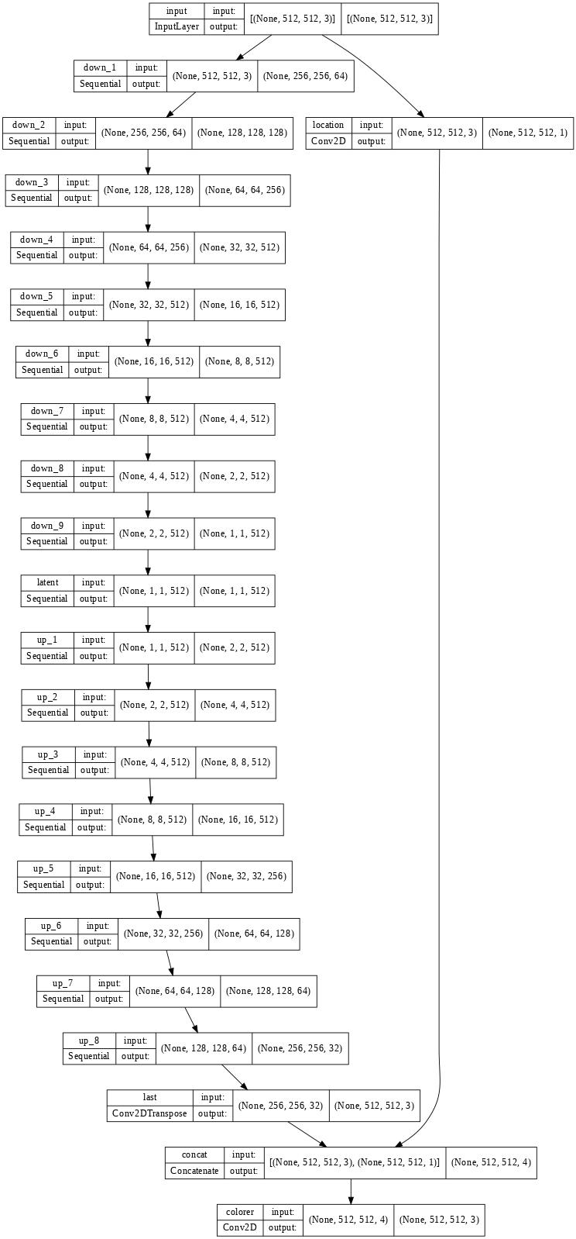
UNET Saliency Map: UNET Layers

Slide 10
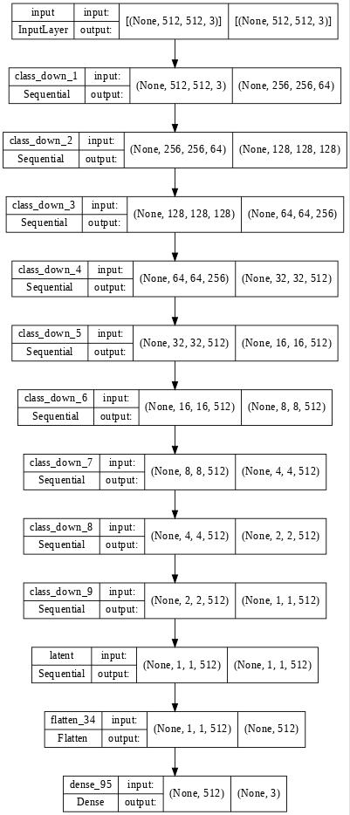
UNET Saliency Map: UNET Classifier Layers

Slide 11
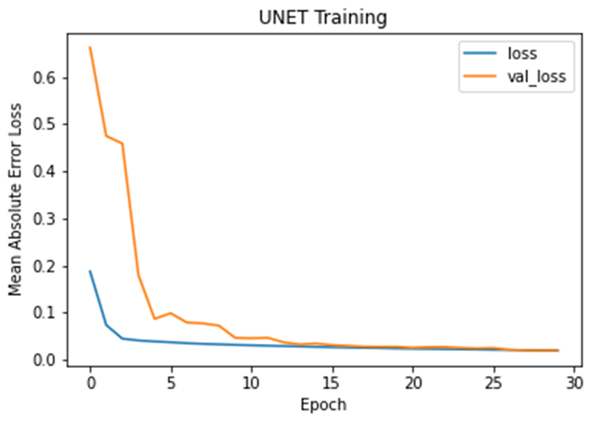
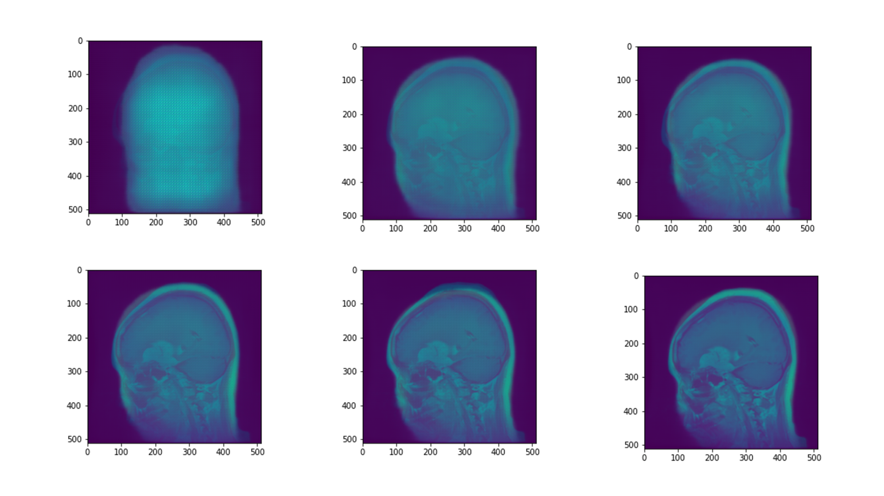
UNET Saliency Map: UNET Results
Full UNET
Epoch 5
Epoch 10
Epoch 15
Epoch 20
Epoch 25
Epoch 30

Slide 12
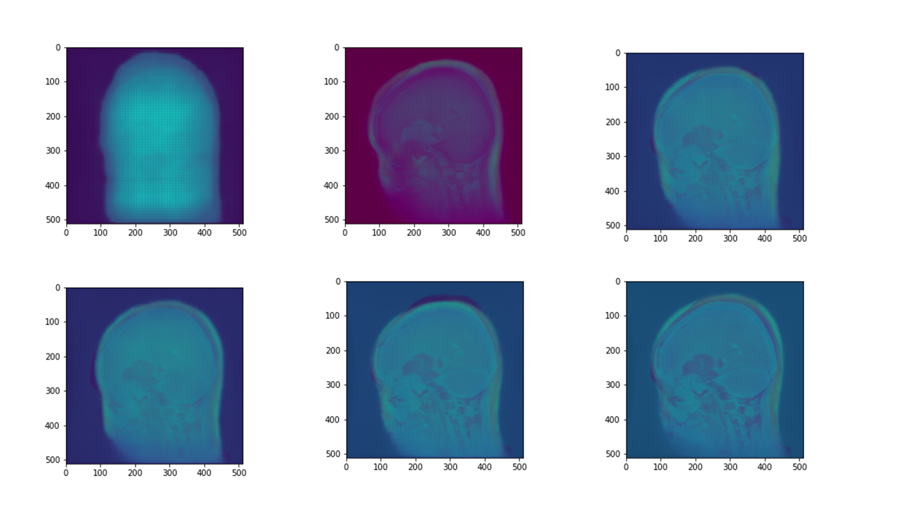
UNET Saliency Map: UNET Results
Step 1: Train UNET
Autoencoder Side
Input image (512x512x3)
Encoder
(Conv Downstep)
Epoch 5
Epoch 10
Epoch 15
Latent (1x1x512)
Skip step
(512x512x1) untrainable
Decoder
(Deconv Upstep)
Positional information
Epoch 20
Epoch 25
Epoch 30
Colorer
Output image
(512x512x3)

Slide 13
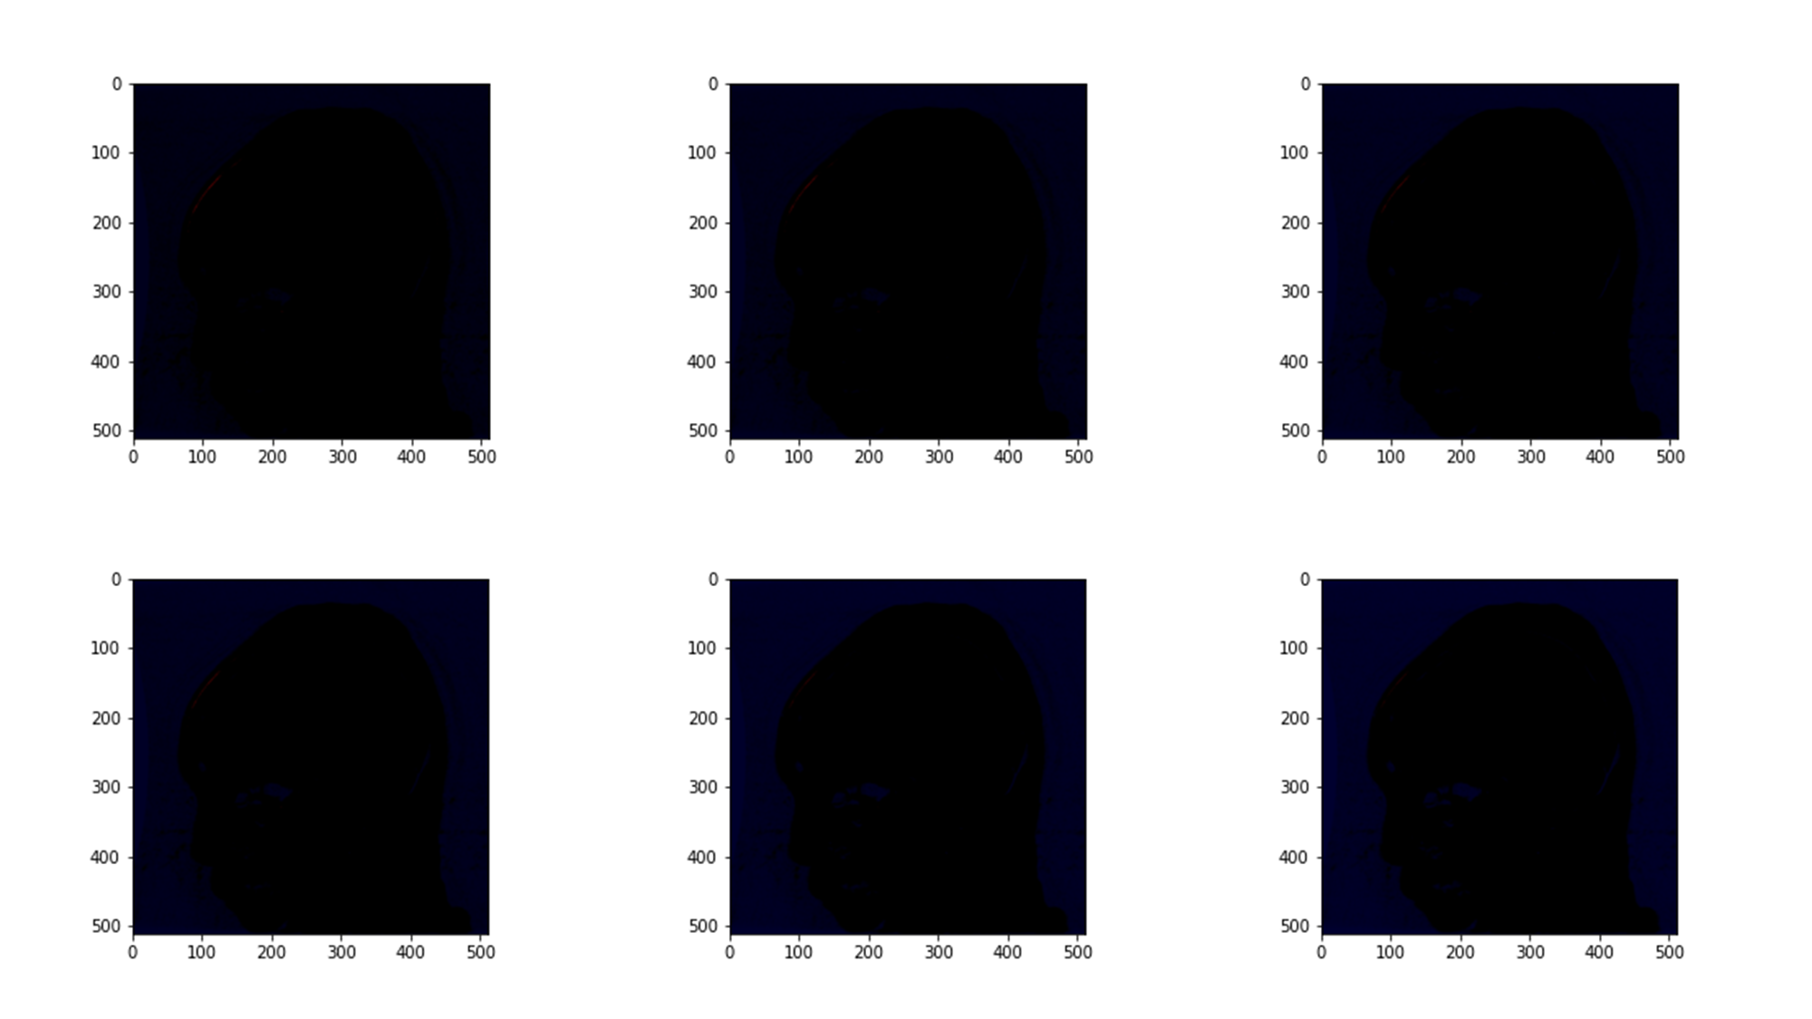
UNET Saliency Map: UNET Results
Step 1: Train UNET
Positional Information Side
Input image (512x512x3)
Encoder
(Conv Downstep)
Epoch 5
Epoch 10
Epoch 15
Latent (1x1x512)
Skip step
(512x512x1) untrainable
Decoder
(Deconv Upstep)
Positional information
Epoch 20
Epoch 25
Epoch 30
Colorer
Output image
(512x512x3)

Slide 14
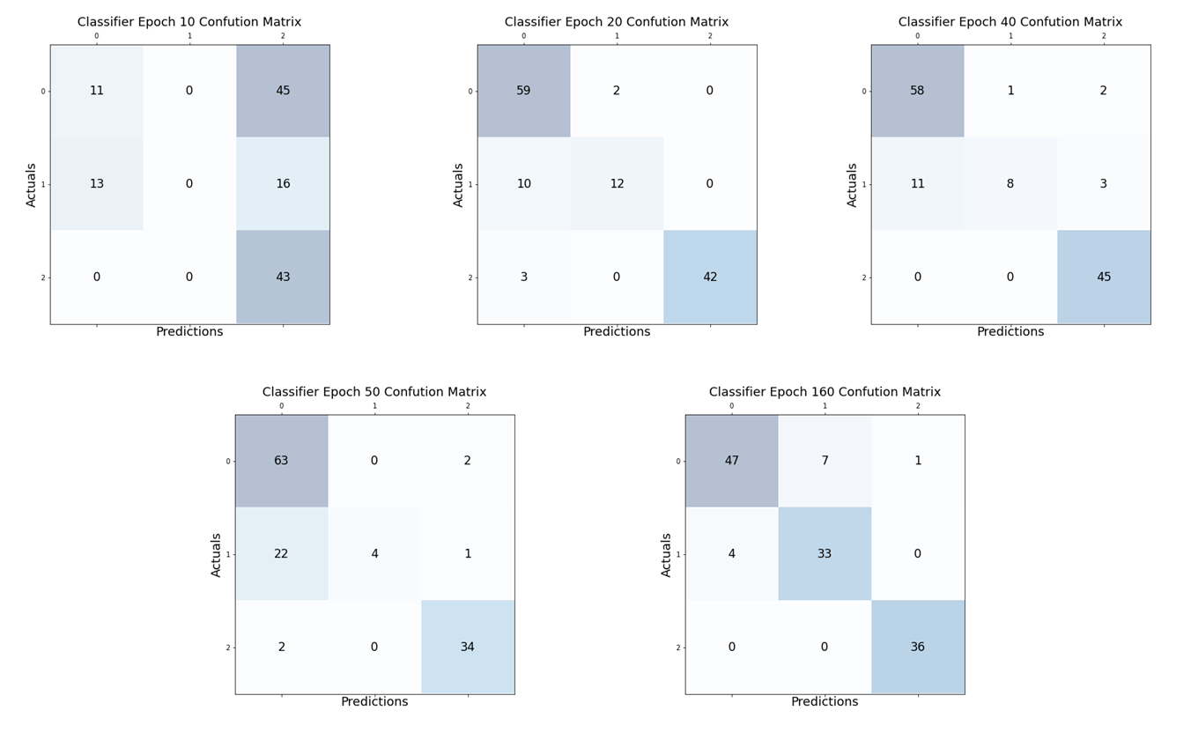
UNET Saliency Map: Encoder Training

Slide 15
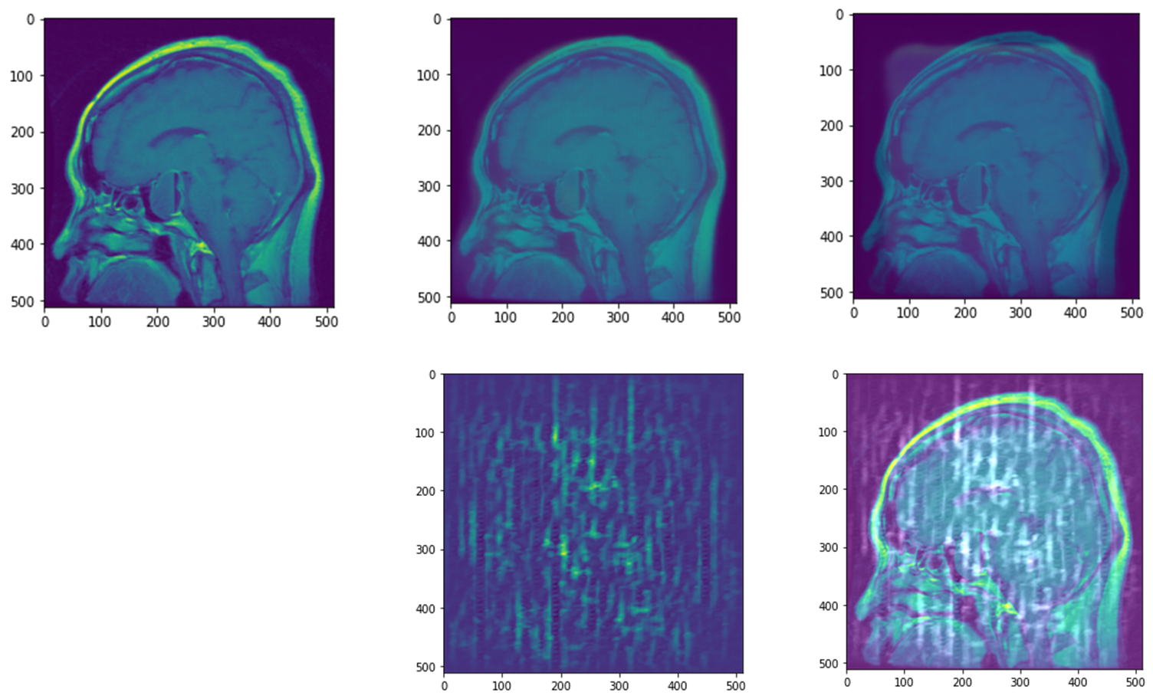
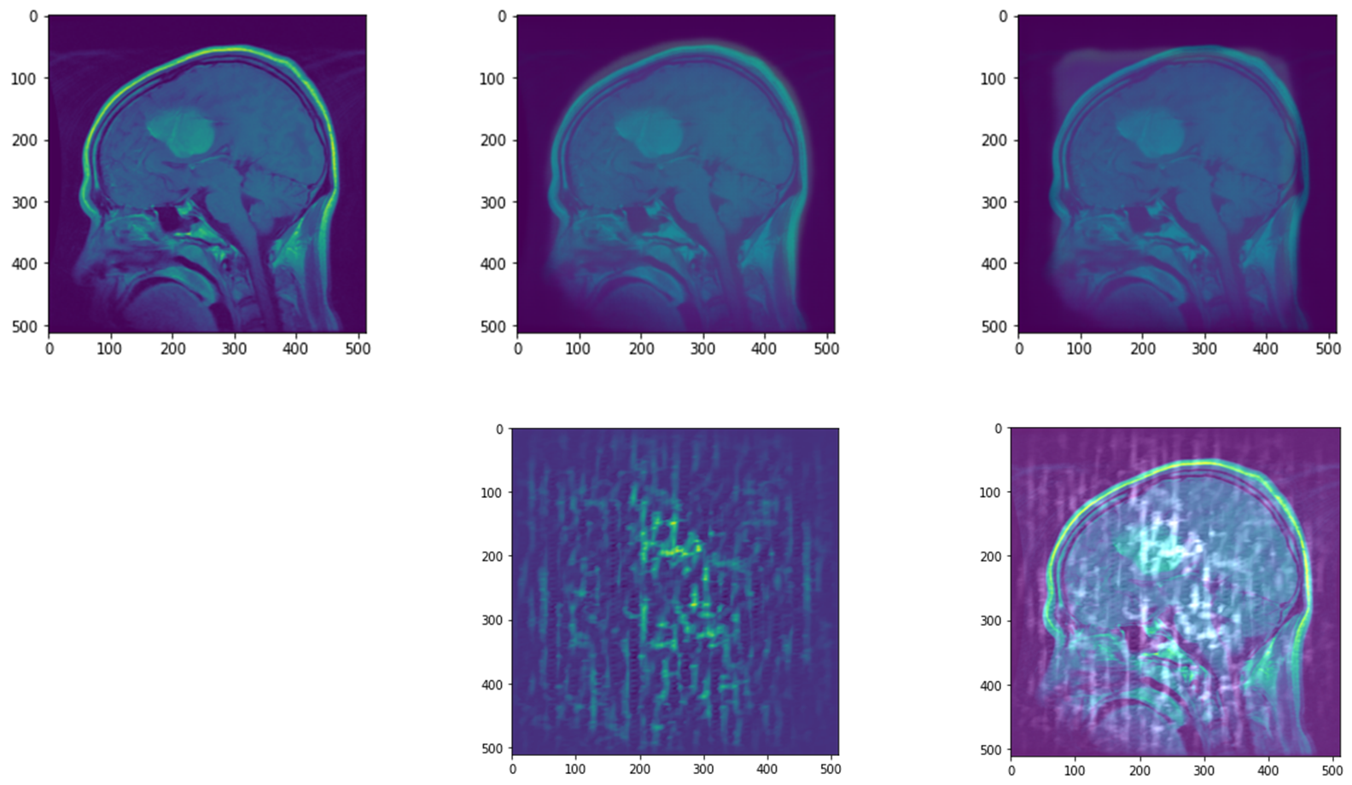
UNET Saliency Map: Encoder Training
Original
UNET
Classifier UNET
Original
UNET
Classifier UNET
Gradients
Gradients on Original
Gradients
Gradients on Original

Slide 16
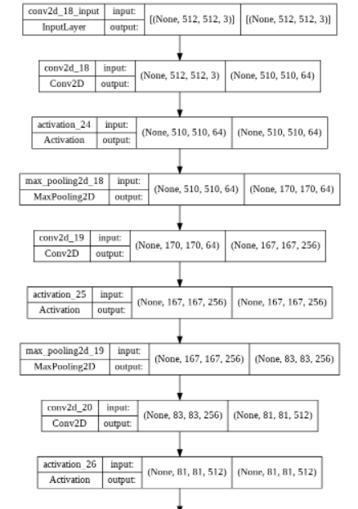
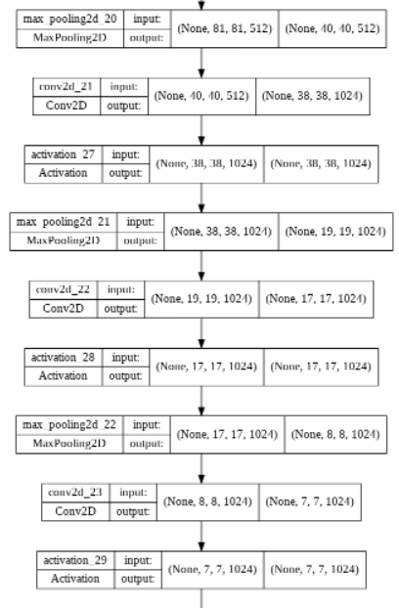
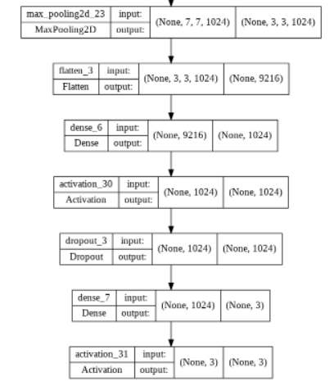
CNN

Slide 17
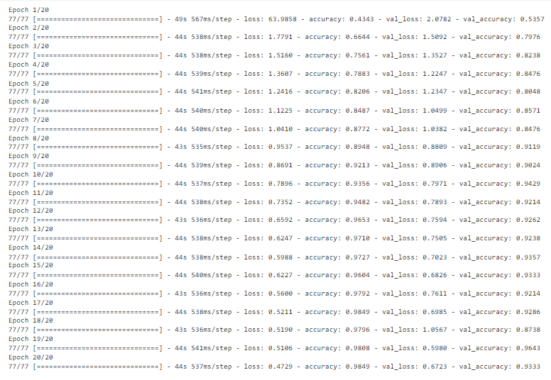
CNN: Results

Slide 18
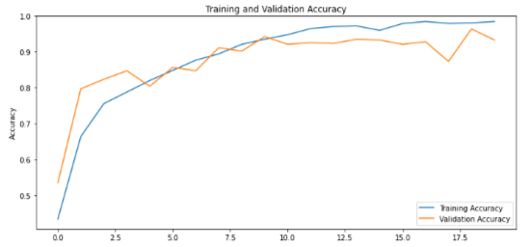
Training and validation accuracy

Slide 19
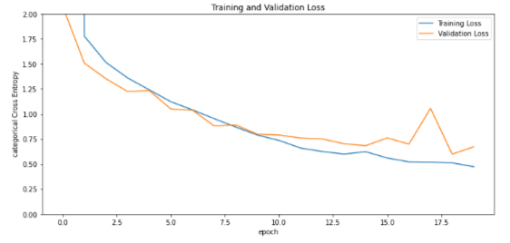
Training and validation loss

Slide 20
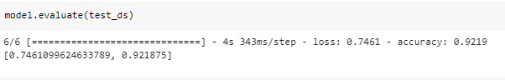
Evaluation on the test data

Slide 21
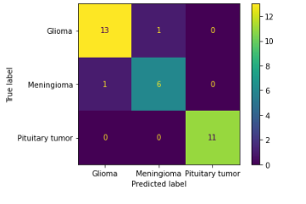
CNN: Confusion matrix

Slide 22
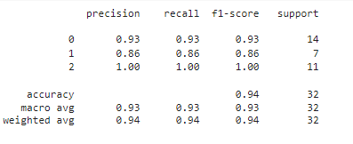
CNN: Accuracy, Precision, Recall & F1 Score

Slide 23
Limitation and Future work
Only VGG-16 was used in transfer learning; try different pretrained models and explore with fine-tuning the whole architecture.
For CNN, only 32 samples has been added in the test dataset
For CNN, 6 layers of Conv layers has been used ; Try CNN model with different layers.
For Saliency Map, even the gradient tape method did not show a clear localization of the tumor. Both methods could be run again on a more localizable dataset.

